Slide 1
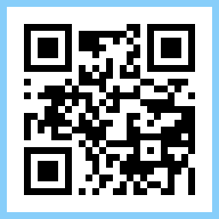

Team Quick Response!
QR Codes

Slide 2
Plan for the Hack
Thursday:
1pm Kick off with donuts and fruit
3pm Charlotte catch up with teams
Friday
Start prepping your showcase
12pm Pizzas in level 3 Djalkat
1:30pm Practice showcases
3pm Present your showcases

Slide 3
Title: Problem / Something trying to learn
One sentence description of the problem (10 words max)

Slide 4
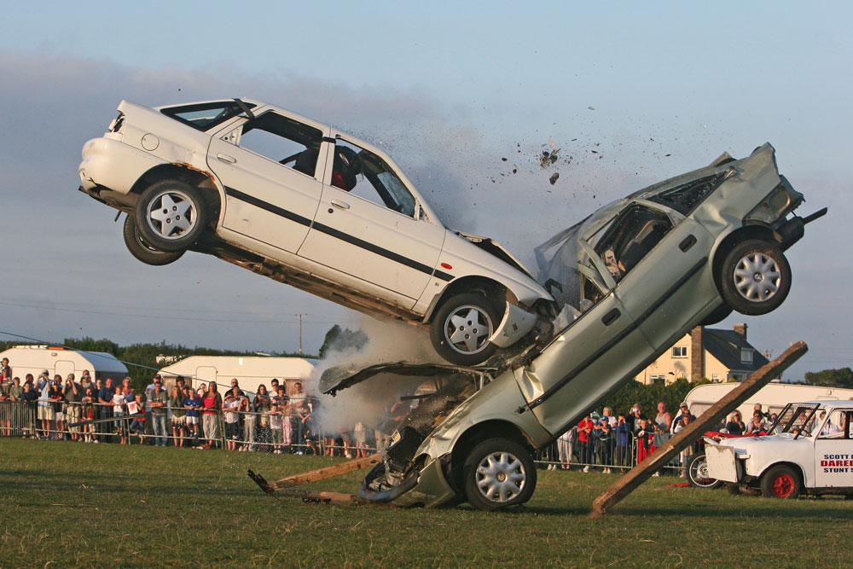
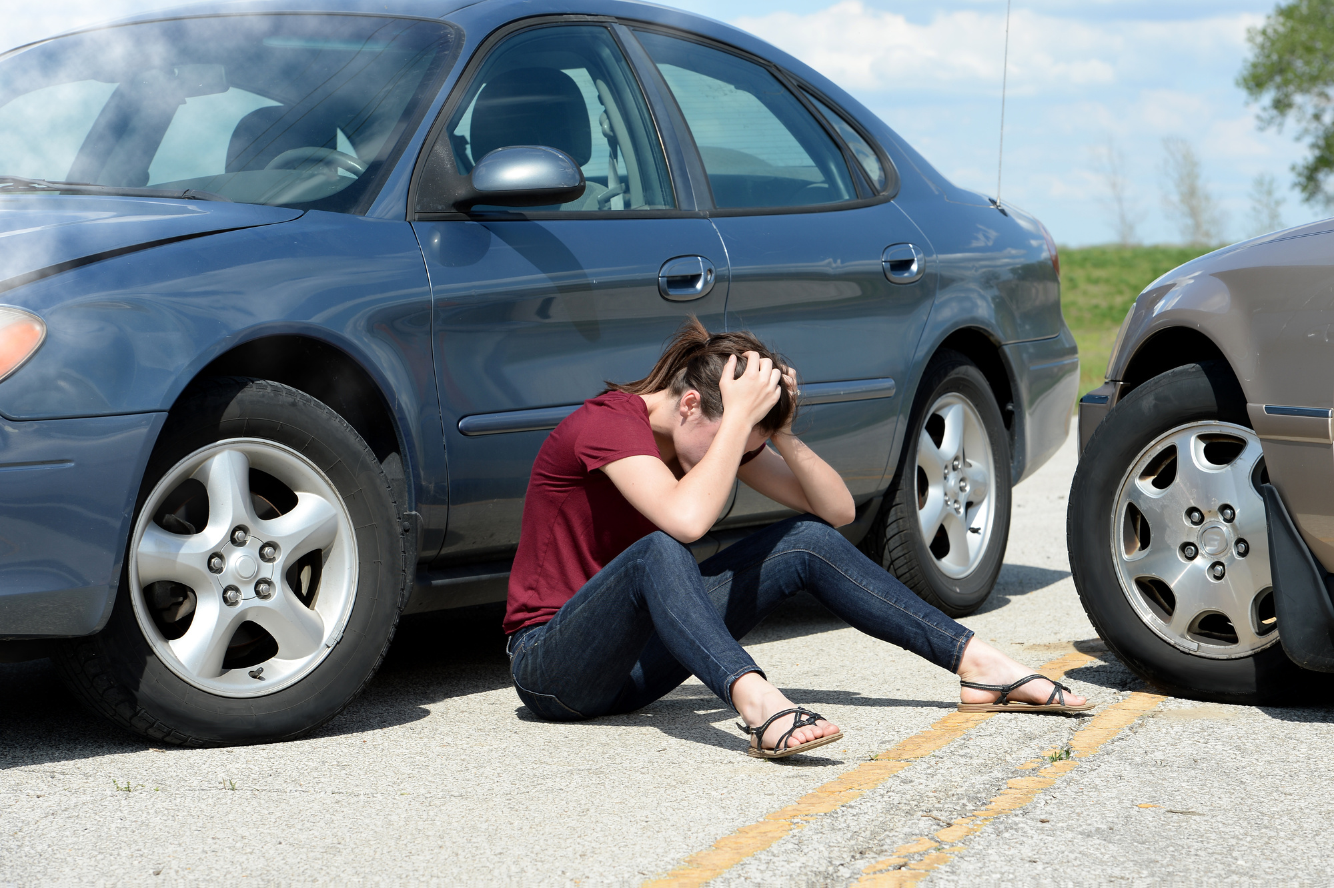
Title: Problem / Something trying to learn

Slide 5
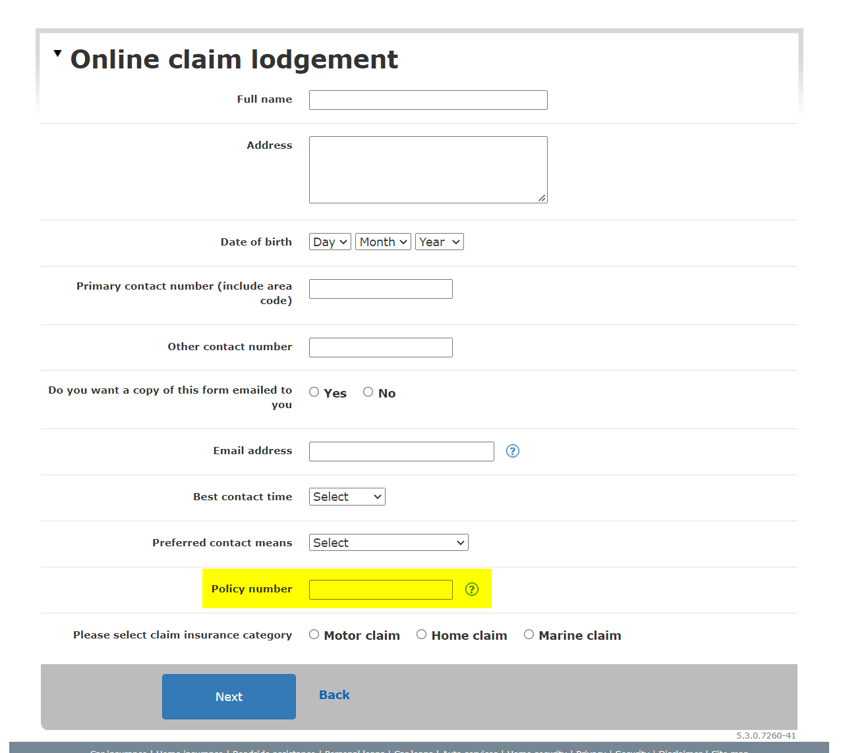
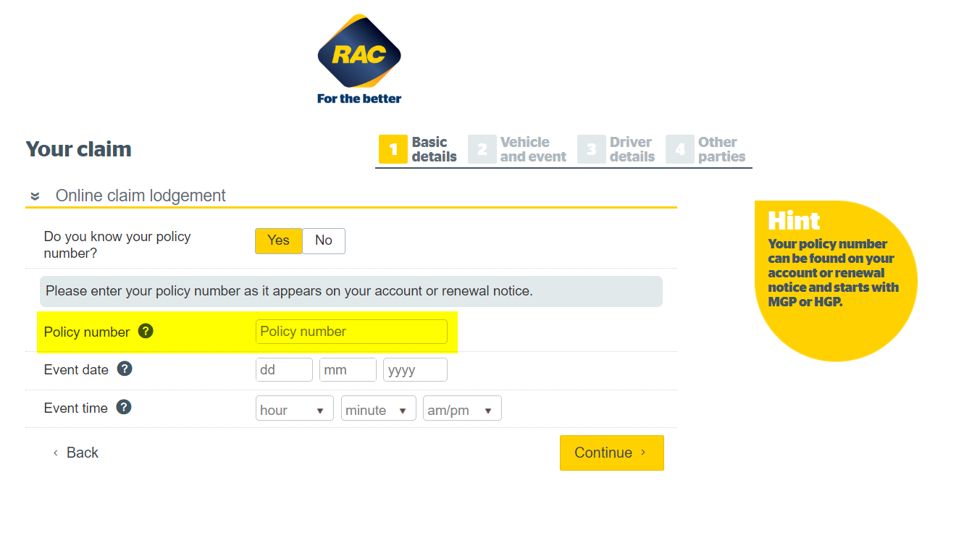
Making a claim

Slide 6
What are QR Codes?
They were created in 1994 by Denso Wave to track vehicles during manufacturing. They quickly gain popularity when it spread to smartphones.
You can now even scan QR Codes from your phone camera.

Slide 7
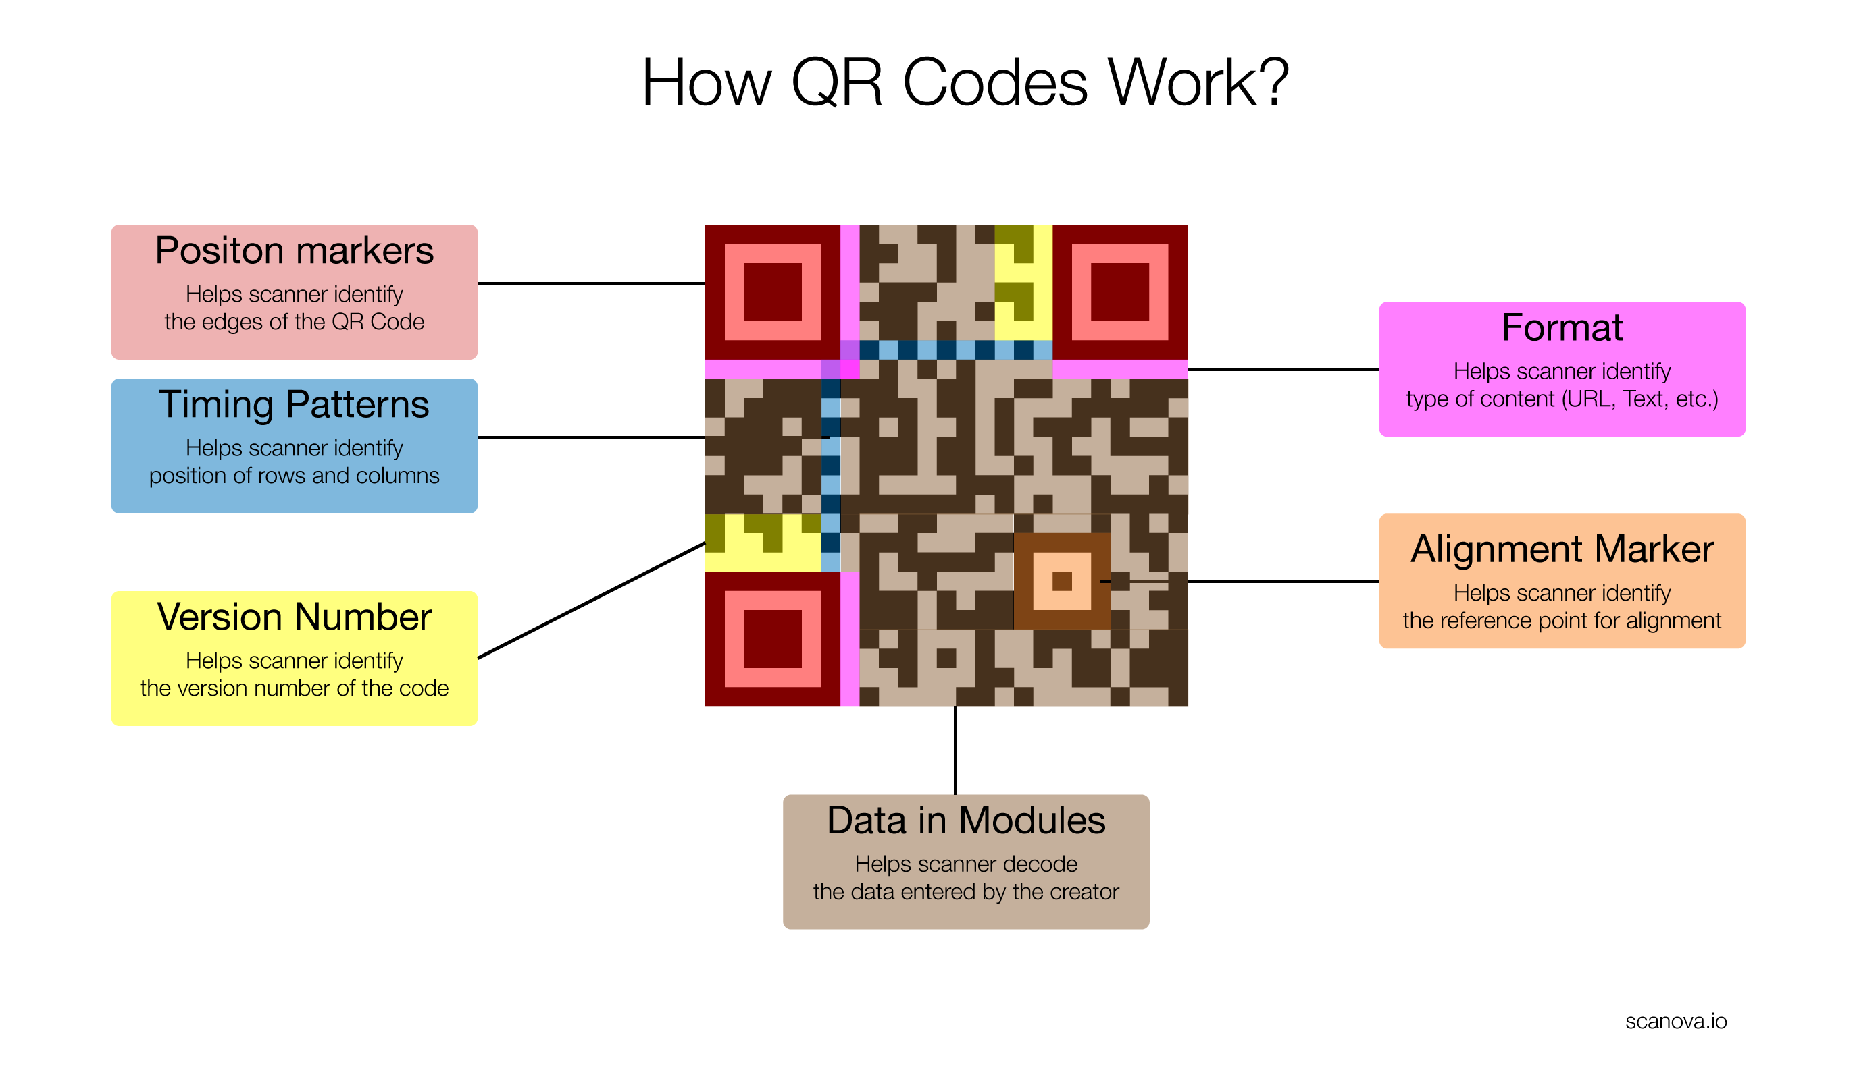
What are QR Codes?

Slide 8
What have you achieved
Give your solution a name
Describe your idea in one sentence (who it will help and how)
Show your solution/idea
Demo
Screen shots
Process flows

Slide 9
What can RAC get out of this
Describe why the idea should be implemented in one sentence
Key Success Metrics i.e.
Business value
Time savings
Cost savings
Member benefits
Training benefit

Slide 10
What have you learnt

Slide 11
What’s next
Share your team name and members with me Charlotte Trembecki
Get hacking!

Slide 12
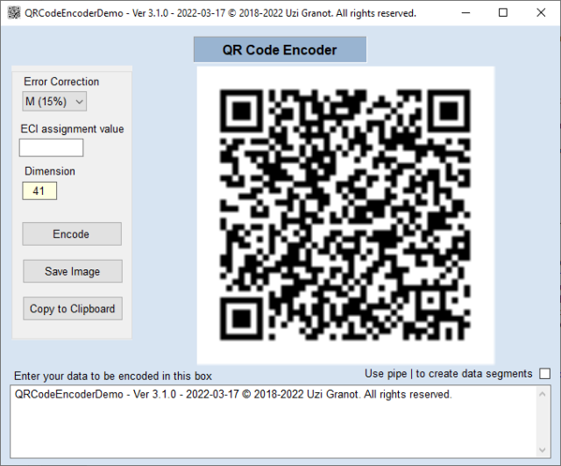
References
https://qr.io/
Encoder and Decoder library for .NET 6 https://www.codeproject.com/Articles/1250071/QR-Code-Encoder-and-Decoder-Csharp-Class-Library-f
Get hacking!

